Slide 1
SC2001/CE2101/CZ2101:
Algorithm Design and Analysis
Insertion Sort
Instructor: Asst. Prof. LIN Shang-Wei
Courtesy of Dr. Ke Yiping, Kelly’s slides
Notes:
In this lecture, we will learn the sorting algorithm, called “Insertion sort”. It is the first of the four sorting algorithms to be learnt in this course. Insertion sort uses the “incremental approach”, which means to solve a problem bit by bit.

Slide 2
Learning Objectives
At the end of this lecture, students should be able to:
Explain the incremental approach as a strategy of algorithm design
Describe how insertion sort algorithm works, by manually running its pseudo code on a toy example
Analyse the time complexities of Insertion sort in the best case, worst case and average case
Notes:
In this lecture, we will achieve the following learning objectives.
First, as Insertion sort uses the incremental approach, we will learn a general strategy of algorithm design using Insertion sort as an example.
Secondly, we will mentally execute the pseudo code of Insertion on a toy input, to understand how the algorithm works.
Then, after ensuring the algorithm works correctly, we will continue to analyse its performance. For Insertion sort, we will analyse its worst-case and average-case running times, which are measured by the number of comparisons between input elements.

Slide 3
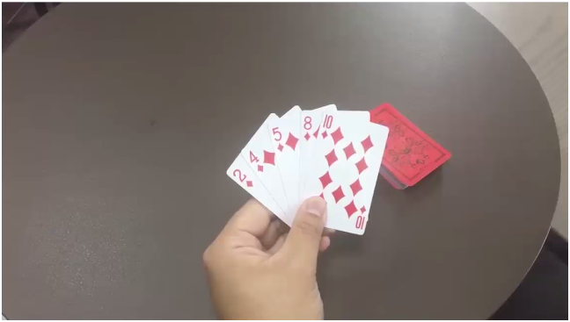
Insertion Sort of a Hand of Cards
Notes:
Detail scene for demonstration
Let’s have a look at the idea behind insertion sort.
When we play cards, how do we sort a hand of cards?
Based on our experience, we typically pick up a new card with the right hand, and insert it into the cards in the left hand.
Let’s have a look at it again to see how we find the correct place for the new card in our left hand.
Firstly, we pick up a new card, number7.
Prior to insertion, the cards in the left hand should have been sorted. Otherwise, it’s not easy to find a place to insert the new card.
Audio: Then, we compare start comparing the new card from the right hand with the first card in left hand.
we will continue comparing as long as the new card number from the right hand is less than the existing cards from left hand.
Finally, we found the location where we can insert the new card .Card number 5 is less than card number 7 and that is where we should insert the our new card, number 7.
You may think, how is it that we don’t need to compare card 7 with the cards 4 and 2, in this example?
It is because the cards in the left hand have already been sorted, and since card 7 is already bigger than card 5, we are sure that it is bigger than every card below card 5.
Hence, we don’t need to compare card 7 with those cards smaller than 5. In fact, we can skip these comparisons and save time. This is the crucial idea behind the insertion sort.

Slide 4
Insertion Sort
sorted list
unsorted list
  The incremental approach
  An intuitive, primitive sorting method
  A form of insertion into an ordered list
  Given an unordered set of objects, repeatedly remove an entry from the set and insert it into a new ordered list
  Ensure that the new list is ordered at all times
  Each insertion requires movements of certain entries in the ordered list
Notes:
Insertion sort uses the incremental approach of algorithm design, which means we solve a problem bit by bit.
Insertion sort is one of the simplest and intuitive method for sorting.
As its name suggests, the key operation of insertion sort is “insertion”, that is, to insert a new item into an ordered list.
Overall, to sort a set of objects, we repeatedly remove an element from the set, and insert it into an ordered list. So that the data can be divided into two parts, unordered set and ordered list respectively.
So gradually, the unordered part will shrink while the ordered list grows, and that is why it is noted as an incremental approach. It is important to ensure that the new list must be ordered at all times, because it allows us to find a proper place to insert the new item quickly. But because of the insertion, we often need to move data to make room for the new item to be inserted.

Slide 5
Insertion Sort (Pseudo Code)
  The incremental approach
    void InsertionSort (ALIST slot[ ], int n)
    { // input slot is an array of n records;
    // assume n > 1;
    for (int i=1; i < n; i++)
    for (int j=i; j > 0; j--) {
    if (slot[j].key < slot[j-1].key)
    swap(slot[j], slot[j-1]);
    else break;
    }
    }
Notes:
Here is the pseudo code for the insertion sort.

Slide 6
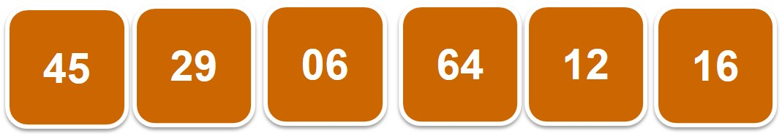
Insertion Sort (Pseudo Code)
    class ALIST {
    KeyType key;
    DataType data;
    };
  The incremental approach
    void InsertionSort (ALIST slot[ ], int n)
    { // input slot is an array of n records;
    // assume n > 1;
    for (int i=1; i < n; i++)
    for (int j=i; j > 0; j--) {
    if (slot[j].key < slot[j-1].key)
    swap(slot[j], slot[j-1]);
    else break;
    }
    }
Notes:
We are given a list or an array of records, called “slot”,

Slide 7
Insertion Sort (Pseudo Code)
  The incremental approach
    void InsertionSort (ALIST slot[ ], int n)
    { // input slot is an array of n records;
    // assume n > 1;
    for (int i=1; i < n; i++)
    for (int j=i; j > 0; j--) {
    if (slot[j].key < slot[j-1].key)
    swap(slot[j], slot[j-1]);
    else break;
    }
    }
0
1
2
3
4
5
Notes:
and n is the size of the input array, that is, the number of records to be sorted.

Slide 8
Insertion Sort (Pseudo Code)
  The incremental approach
    void InsertionSort (ALIST slot[ ], int n)
    { // input slot is an array of n records;
    // assume n > 1;
    for (int i=1; i < n; i++)
    for (int j=i; j > 0; j--) {
    if (slot[j].key < slot[j-1].key)
    swap(slot[j], slot[j-1]);
    else break;
    }
    }
0
1
2
3
4
5
Notes:
Let’s assume that n is larger than one. If n is less than or equal to one, there is no need to sort it.

Slide 9
Insertion Sort (Pseudo Code)
  The incremental approach
    void InsertionSort (ALIST slot[ ], int n)
    { // input slot is an array of n records;
    // assume n > 1;
    for (int i=1; i < n; i++)
    for (int j=i; j > 0; j--) {
    if (slot[j].key < slot[j-1].key)
    swap(slot[j], slot[j-1]);
    else break;
    }
    }
Notes:
The algorithm consists of a double “for” loop.
In the outer for loop, we have the running index i, which starts from one, and the condition is that i is less than n.
For each iteration, i is increased by one. Here, the index of an array starts from 0, as in C or C++.
But in the outer for loop, why do we start from one instead of zero? It is because the first element, with index 0, does not have to be inserted.

Slide 10
Insertion Sort (Pseudo Code)
  The incremental approach
    void InsertionSort (ALIST slot[ ], int n)
    { // input slot is an array of n records;
    // assume n > 1;
    for (int i=1; i < n; i++)
    for (int j=i; j > 0; j--) {
    if (slot[j].key < slot[j-1].key)
    swap(slot[j], slot[j-1]);
    else break;
    }
    }
Pick up a new item from slot[ ]
sorted list
unsorted list
i
Notes:
Basically the outer for loop is to pick up a new item, the i-th item from the set, which is to be inserted.

Slide 11
Insertion Sort (Pseudo Code)
  The incremental approach
    void InsertionSort (ALIST slot[ ], int n)
    { // input slot is an array of n records;
    // assume n > 1;
    for (int i=1; i < n; i++)
    for (int j=i; j > 0; j--) {
    if (slot[j].key < slot[j-1].key)
    swap(slot[j], slot[j-1]);
    else break;
    }
    }
Find the correct position to insert
the item.
sorted list
unsorted list
i,j
Notes:
Then, the goal of the inner for loop is to find the correct position to insert the item.
To do that, we need to search for the position, and then insert it there.

Slide 12
Insertion Sort (Pseudo Code)
  The incremental approach
    void InsertionSort (ALIST slot[ ], int n)
    { // input slot is an array of n records;
    // assume n > 1;
    for (int i=1; i < n; i++)
    for (int j=i; j > 0; j--) {
    if (slot[j].key < slot[j-1].key)
    swap(slot[j], slot[j-1]);
    else break;
    }
    }
sorted list
unsorted list
j
Notes:
So the running index j, for the inner for loop, starts from i; for each iteration, j decreases by one; and the condition is that j must be larger than zero.
When j is equal to 0, it means the search has reached the left end, which is when we need to stop the search since we have run out of element to compare.

Slide 13
Insertion Sort (Pseudo Code)
  The incremental approach
    void InsertionSort (ALIST slot[ ], int n)
    { // input slot is an array of n records;
    // assume n > 1;
    for (int i=1; i < n; i++)
    for (int j=i; j > 0; j--) {
    if (slot[j].key < slot[j-1].key)
    swap(slot[j], slot[j-1]);
    else break;
    }
    }
compare
sorted list
unsorted list
j
Notes:
Inside the inner for loop, we compare the j-th key with its neighbour on the left side, with index j – 1.
If the neighbour on the left side is bigger, it means the pair of records (at indexes j and j – 1) are out of order.

Slide 14
Insertion Sort (Pseudo Code)
  The incremental approach
    void InsertionSort (ALIST slot[ ], int n)
    { // input slot is an array of n records;
    // assume n > 1;
    for (int i=1; i < n; i++)
    for (int j=i; j > 0; j--) {
    if (slot[j].key < slot[j-1].key)
    swap(slot[j], slot[j-1]);
    else break;
    }
    }
swap
sorted list
unsorted list
Notes:
As a next step, we will swap them to make their order into ascending order.

Slide 15
Insertion Sort (Pseudo Code)
  The incremental approach
    void InsertionSort (ALIST slot[ ], int n)
    { // input slot is an array of n records;
    // assume n > 1;
    for (int i=1; i < n; i++)
    for (int j=i; j > 0; j--) {
    if (slot[j].key < slot[j-1].key)
    swap(slot[j], slot[j-1]);
    else break;
    }
    }
sorted list
unsorted list
j
Notes:
After that, we continue to the next iteration of the inner for loop, to look further to the left side.
This is continued until either we find the correct position for insertion or when we have reached the left end of the list.

Slide 16
Insertion Sort (Pseudo Code)
  The incremental approach
    void InsertionSort (ALIST slot[ ], int n)
    { // input slot is an array of n records;
    // assume n > 1;
    for (int i=1; i < n; i++)
    for (int j=i; j > 0; j--) {
    if (slot[j].key < slot[j-1].key)
    swap(slot[j], slot[j-1]);
    else break;
    }
    }
What does it mean?
The correct position was found!!
Notes:
When “else” is true, it means the j-th key value is larger than or equal to the neighbour on the left side.
When that happens, we will know for sure that a correct position has been found and we can insert the new element there, by executing the command of “break”.

Slide 17
Insertion Sort (Pseudo Code)
  The incremental approach
    void InsertionSort (ALIST slot[ ], int n)
    { // input slot is an array of n records;
    // assume n > 1;
    for (int i=1; i < n; i++)
    for (int j=i; j > 0; j--) {
    if (slot[j].key < slot[j-1].key)
    swap(slot[j], slot[j-1]);
    else break;
    }
    }
sorted list
unsorted list
i
Notes:
At that time, we will be done with the i-th element to be inserted, and will pick up the next element to insert by executing the next iteration of the outer for loop.

Slide 18
Insertion Sort Example

Slide 19
Insertion Sort Example
Sort in ascending order
Index j
0
1
2
3
4
5
45
29
06
64
12
16
Notes:
Now, let’s look at an example of insertion sort.
We are given this array of integers, and our goal is to sort it in the ascending order.

Slide 20
Insertion Sort Example
Index j
0
1
2
3
4
5
45
29
06
64
12
16
i
Notes:
Here, 45 is the first element.

Slide 21
Insertion Sort Example
Index j
0
1
2
3
4
5
45
29
06
64
12
16
i
Notes:
We use blue colour to indicate that this part of the array, consisting of only one element, has been sorted.

Slide 22
Insertion Sort Example
Index j
0
1
2
3
4
5
45
29
06
64
12
16
i
Notes:
The first element to be inserted is actually the second element in the input array, which is 29 here.

Slide 23
Insertion Sort Example
    If (slot[j].key < slot[j-1].key)
    (slot[1].key < slot[0].key)
    29 < 45
✓
Index j
0
1
2
3
4
5
45
29
06
64
12
16
i
Notes:
According to the algorithm, we now compare 29 with its neighbour on the left, which is 45.
Since 29 is smaller than its left neighbour 45, the two elements are out of order, that is, they are not in the ascending order.

Slide 24
Insertion Sort Example
swap(slot[j], slot[j-1]);
swap(slot[1], slot[0]);
Index j
0
1
2
3
4
5
45
29
06
64
12
16
i
Notes:
In this case, we swap them.
After the swap, the new index of key 29 becomes 0, meaning that it has reached the left end position,

Slide 25
Insertion Sort Example
Index j
0
1
2
3
4
5
29
45
06
64
12
16
i
Notes:
so we have finished inserting element 29.

Slide 26
Insertion Sort Example
    If (slot[j].key < slot[j-1].key)
    (slot[2].key < slot[1].key)
    06 < 45
✓
Index j
0
1
2
3
4
5
29
45
06
64
12
16
i
Notes:
Next, we look at the element 6.
Just like how 29 was inserted, we will now compare 6 with its left neighbour 45,

Slide 27
Insertion Sort Example
swap(slot[j], slot[j-1]);
swap(slot[2], slot[1]);
Index j
0
1
2
3
4
5
29
45
06
64
12
16
i
Notes:
and swap them because the left neighbour is bigger,

Slide 28
Insertion Sort Example
    If (slot[j].key < slot[j-1].key)
    (slot[1].key < slot[0].key)
    06 < 29
✓
Index j
0
1
2
3
4
5
29
06
45
64
12
16
i
Notes:
And then we continue to compare element 6 with its left neighbour 29, and 6 is smaller than 29.

Slide 29
Insertion Sort Example
swap(slot[j], slot[j-1]);
swap(slot[1], slot[0]);
Index j
0
1
2
3
4
5
29
06
45
64
12
16
i
Notes:
so we swap again between 6 and 29.

Slide 30
Insertion Sort Example
Index j
0
1
2
3
4
5
06
29
45
64
12
16
i
Notes:
In this way, we insert 6 at the left end of the array.

Slide 31
Insertion Sort Example
    If (slot[j].key < slot[j-1].key)
    (slot[3].key < slot[2].key)
    64 < 45
    ✗
Index j
0
1
2
3
4
5
06
29
45
64
12
16
i
Notes:
For the next element 64,
because it is bigger than the left neighbour 45, we don’t need to do any swaps.
Although no swap is needed, one comparison between the two keys 64 and 45 is still needed.

Slide 32
Insertion Sort Example
    If (slot[j].key < slot[j-1].key)
    (slot[4].key < slot[3].key)
    12 < 64
✓
Index j
0
1
2
3
4
5
06
29
45
64
12
16
i
Notes:
For element 12, four comparisons would be needed,
First of all we compare 12 with 64,

Slide 33
Insertion Sort Example
swap(slot[j], slot[j-1]);
swap(slot[4], slot[3]);
Index j
0
1
2
3
4
5
06
29
45
64
12
16
i
Notes:
and they will be swapped since 12 is less than 64.

Slide 34
Insertion Sort Example
    If (slot[j].key < slot[j-1].key)
    (slot[3].key < slot[2].key)
    12 < 45
✓
Index j
0
1
2
3
4
5
06
29
45
12
64
16
i
Notes:
Then we continue to compare 12 with 45,

Slide 35
Insertion Sort Example
swap(slot[j], slot[j-1]);
swap(slot[3], slot[2]);
Index j
0
1
2
3
4
5
06
29
45
12
64
16
i
Notes:
12 and 45 should be swapped since 12 is less than 45.

Slide 36
Insertion Sort Example
    If (slot[j].key < slot[j-1].key)
    (slot[2].key < slot[1].key)
    12 < 29
✓
Index j
0
1
2
3
4
5
06
29
12
45
64
16
i
Notes:
Then , we compare 12 with 29.

Slide 37
Insertion Sort Example
swap(slot[j], slot[j-1]);
swap(slot[2], slot[1]);
Index j
0
1
2
3
4
5
06
29
12
45
64
16
i
Notes:
12 and 29 will be swapped.

Slide 38
Insertion Sort Example
    If (slot[j].key < slot[j-1].key)
    (slot[1].key < slot[0].key)
    12 < 06
    ✗
Index j
0
1
2
3
4
5
06
12
29
45
64
16
i
Notes:
12 does not need to swap with 6, because they are already in the correct order, but the comparison between them is still needed. Without this last comparison, we wouldn’t be sure that 12 is larger than 6.

Slide 39
Insertion Sort Example
    If (slot[j].key < slot[j-1].key)
    (slot[5].key < slot[4].key)
    16 < 64
✓
Index j
0
1
2
3
4
5
06
12
29
45
64
16
i
Notes:
Likewise, to insert 16,
we need 4 comparisons.
Compare 16 with 64.

Slide 40
Insertion Sort Example
swap(slot[j], slot[j-1]);
swap(slot[5], slot[4]);
Index j
0
1
2
3
4
5
06
12
29
45
64
16
i
Notes:
Swap the position of 16 with 64 since the condition for a swap is satisfied.

Slide 41
Insertion Sort Example
    If (slot[j].key < slot[j-1].key)
    (slot[4].key < slot[3].key)
    16 < 45
✓
Index j
0
1
2
3
4
5
06
12
29
45
16
64
i
Notes:
Then we continue to compare 16 with 45.

Slide 42
Insertion Sort Example
swap(slot[j], slot[j-1]);
swap(slot[4], slot[3]);
Index j
0
1
2
3
4
5
06
12
29
45
16
64
i
Notes:
Swap the position of 16 and 45.

Slide 43
Insertion Sort Example
    If (slot[j].key < slot[j-1].key)
    (slot[3].key < slot[2].key)
    16 < 29
✓
Index j
0
1
2
3
4
5
06
12
29
16
45
64
i
Notes:
Compare 16 with 29.

Slide 44
Insertion Sort Example
swap(slot[j], slot[j-1]);
swap(slot[3], slot[2]);
Index j
0
1
2
3
4
5
06
12
29
16
45
64
i
Notes:
Swap their position since the condition is satisfied.

Slide 45
Insertion Sort Example
    If (slot[j].key < slot[j-1].key)
    (slot[2].key < slot[1].key)
    16 < 12
    ✗
Index j
0
1
2
3
4
5
06
12
16
29
45
64
i
Notes:
The last comparison, between 16 and 12, is to confirm that between 12 and 29 is the correct position to insert 16.

Slide 46
Insertion Sort Example
Sorted in ascending order
Index j
0
1
2
3
4
5
06
12
16
29
45
64
Notes:
Finally our array is sorted in ascending order using insertion sort.

Slide 47
Insertion Sort Algorithm
(Recap)
Notes:
Let’s have a look the recap of insertion sort algorithm.

Slide 48
Insertion Sort Algorithm
Original unsorted set and final sorted list are both in array
slot[ ]. (in-place sorting)
06
12
29
45
64
16
Notes:
Here both the input and output data are held in the same array.

Slide 49
Insertion Sort Algorithm
Original unsorted set and final sorted list are both in array
slot[ ]. (in-place sorting)
Since sorting is performed directly on original array without any working storage, swapping and shifting are essential.
06
12
29
45
64
16
Notes:
It is a nice property of the algorithm that no extra working space is needed.
But the cost is that we need to do swapping and shifting, which will take some time. When the size of a record is big, this will be time consuming.

Slide 50
Insertion Sort Algorithm
Original unsorted set and final sorted list are both in array
slot[ ].
Since sorting is performed directly on original array without any working storage, swapping and shifting are essential.
During sorting, slot[ ] contains sorted portion on the ‘left’ and unsorted portion on the ‘right’; sorted portion grows while unsorted portion shrinks.
Sorted
Unsorted
06
12
29
45
64
16
Notes:
In the pseudo code, the array “slot” contains two portions:
The left portion contains elements that have been sorted, and the rest of the elements in the right portion are unsorted.
The left sorted portion will grow gradually and the right unsorted portion will shrink, until the sorted portion spans the whole array.
Therefore, the insertion sort algorithm is an incremental approach, because the problem is solved bit by bit.

Slide 51
Insertion Sort Algorithm
  In the outer ‘for’ loop, i begins with 1 because the ordered list begins with one element (slot[0]); hence slot[1] is the first element from the unordered list.
    for (int i=1; i < n; i++)
    for (int j=i; j > 0; j--) {
    if (slot[j].key < slot[j-1].key)
    swap(slot[j], slot[j-1]);
    else break;
}
Notes:
Let’s rephrase the pseudo code in plain English.
In the outer for loop, the running index i starts from one, because at the beginning the subarray consisting of slot 0, the element at the very beginning of the input array, has already been sorted.

Slide 52
Insertion Sort Algorithm
  At each iteration, number at slot[ i ] is inserted into the new ordered list.
    for (int i=1; i < n; i++)
    for (int j=i; j > 0; j--) {
    if (slot[j].key < slot[j-1].key)
    swap(slot[j], slot[j-1]);
    else break;
Notes:
As such, slot 1, which is the second element of the whole array, is the first element in the unordered list.
At each iteration, the element at the i-th position, that is slot i, will be inserted into the ordered list.

Slide 53
Insertion Sort Algorithm
  The inner ‘for’ loop finds the correct position in the ordered list by swapping slot[ j ] with slot[ j-1 ] as long as the key of slot[ j-1 ] is > the key of slot[ j ].
    for (int i=1; i < n; i++)
    for (int j=i; j > 0; j--) {
    if (slot[j].key < slot[j-1].key)
    swap(slot[j], slot[j-1]);
    else break;
Notes:
In the inner for loop, we find the position for the i-th element to be inserted. Whenever we find that the left neighbour is larger,

Slide 54
Insertion Sort Algorithm
  The inner ‘for’ loop finds the correct position in the ordered list by swapping slot[ j ] with slot[ j-1 ] as long as the key of slot[ j-1 ] is > the key of slot[ j ].
    for (int i=1; i < n; i++)
    for (int j=i; j > 0; j--) {
    if (slot[j].key < slot[j-1].key)
    swap(slot[j], slot[j-1]);
    else break;
Notes:
we will swap, because in the ascending order the left neighbour is supposed to be smaller. When two neighbouring elements are out of order, a swap can correct their order.

Slide 55
Complexity of Insertion Sort
Notes:
After understanding how the algorithm works, we ask the question:
What is the time complexity of insertion sort?

Slide 56
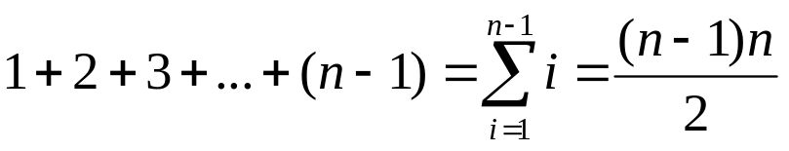
Complexity of Insertion Sort
compare
sorted list
unsorted list
Number of key comparisons:
  There are n − 1 iterations (the outer loop)
  Best case: 1 key comparison/ iteration, total: n − 1
    Already sorted: [06] [12] [16] [29] [45] [64]
  Worst case: i key comparisons for the ith iteration
    Reversely sorted: [64] [45] [29] [16] [12] [06]
i
  Total:
Notes:
Here the running time is measured by the number of comparisons between the keys of records (or, “key comparisons” in short).
After studying the pseudo code of Insertion sort, we can see that the outer for loop will always be executed for n – 1 iterations, where n is the number of input records.
Then, the running time will depend on how many iterations the inner for loop will be executed when the i-th element is inserted.
In the best case, each time when a new element is inserted, it only needs to be compared with its neighbour on the left side, and we don’t do any swaps.
It happens when the input array is already sorted in the correct order, so that when the i-th element is picked to be inserted, its left neighbour is already smaller than it, so no swap is needed.
Overall, n – 1 key comparisons are executed in the best case.
Then, what is the worst case? The worst case is when the i-th element to be inserted needs the maximum number of comparisons, which occurs when the input array is reversely sorted, that is, in the opposite direction as the objective.
In that case, the i-th element would have to be compared with every neighbour to the left side of it, and swap with each of them.
The comparisons and swaps will continue all the way until it reaches the left most end of the array. As such, the i-th element will need i key comparisons. Overall, the total number of key comparisons will be the sum of the arithmetic series, 1 + 2 + 3 and so on till plus n – 1.
By the formula of arithmetic series, the worst total number of key comparisons is n times n – 1 divided by 2.
So it is big Oh of n squared.

Slide 57
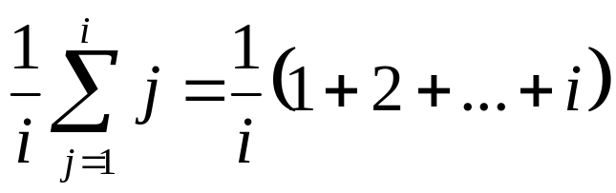
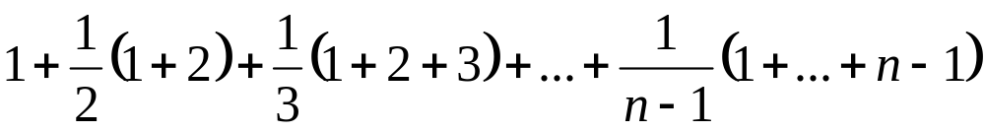
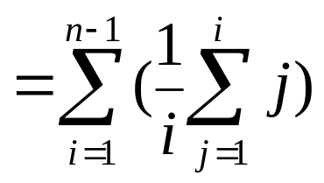
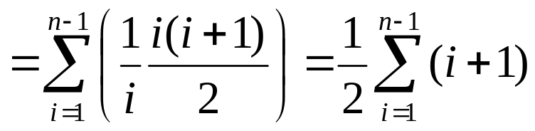
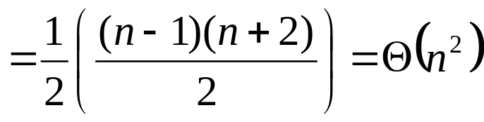
Insertion Sort Performance
  Average case: the ith iteration may have 1, 2, …, i key comparisons, each with 1/i chance.
The average no. of comparisons in the ith iteration:
compare
sorted list
unsorted list
Summation for the n-1 iterations:
i
Notes:
And what about the average case? Average case means that we need to consider all possible input data and calculate the average of the algorithm’s running times over the different cases. So, for the i-th element there could be all these possible numbers of comparisons, from 1 to i, depending on the content of input array, and let’s assume that they have equal probability of one divided by i.
Then, we need to sum up the numbers of key comparisons of the i cases. Here the average or expected number of key comparisons for the i-th iteration of the outer for-loop is the weighted sum of the numbers, where the weight is the probability of each case, that is, one over i.
Then, for all the n – 1 iterations of the outer for-loop,
we have the sum of the sums.
Let us represent the sum of sums in a more compacted form of summation by big sigma.
To simplify the summation, we first use the formula of arithmetic series, to calculate the summation inside the brackets.
After that, the two “i” in the numerator and denominator can be cancelled, and the 1 over 2 can be moved to the front.
Then, the summation will be an arithmetic series.
So the average sum is about n squared divided by four, which is big theta of n squared.
We can see that the average running time of insertion sort is also n squared, asymptotically the same as the worst case, although the constant multiplier is smaller than the worst case.

Slide 58
Insertion Sort Performance
Strengths:
  Good when the unordered list is almost sorted.
  Need minimum time to verify if the list is sorted.
  Fast with linked storage implementation: no movement of data.
Weaknesses:
  When an entry is inserted, it may still not be in the final position yet.
  Every new insertion necessitates movements for some inserted entries in ordered list.
  When each slot is large (e.g., a slot contains a large record of 10Mb), movement is expensive.
  Less suitable with contiguous storage implementation.
Notes:
Here is a summary of the strengths and weaknesses of Insertion sort.
We know that the best case for Insertion sort is when the input list has been already sorted. Actually, even if the input is not exactly sorted, but almost sorted, which means for most of the elements the order has been correct, then Insertion sort is also very fast.
In other words, when the input is sorted, the time to verify the order would be very fast. For each element we just need to check with its left neighbour and we are done. Since swap is often needed, the algorithm can be fast if it is implemented using linked storage (such as a linked list), to avoid movement of big trunk of data.
On the other hand, the weaknesses of Insertion sorts are also obvious. First, when a new element is inserted, it may not be in the final position as yet, but may still be moved in the future. When a new element is inserted, you need to make a room for it. Because of that, movement of data will be needed, which might be time consuming, especially when the slot is large containing lots of data. So if you use some contiguous storage like an array, then the performance might be bad. When using Insertion sort, we need to carefully choose the right data structure.

Slide 59
Summary
Insertion sort uses the incremental approach.
Main idea: Repeatedly pick up an element x to insert into a sorted sub-array on the left side, by comparing x with its left neighbour. If they are out of order, swap them; otherwise, insert x there.
Index j
0
1
2
3
4
5
45
29
06
64
12
16
Notes:
In this lecture, we have learned the algorithm of Insertion sort. It uses the incremental approach of algorithm design.<< animation 1>>
The procedure of Insertion sort is very similar to how card players sort the cards in their hands.

Slide 60
Summary
Insertion sort uses the incremental approach.
Main idea: Repeatedly pick up an element x to insert into a sorted sub-array on the left side, by comparing x with its left neighbour. If they are out of order, swap them; otherwise, insert x there.
Index j
0
1
2
3
4
5
45
29
06
64
12
16
Notes:
Basically, we scan an input array from left to right, using a for loop.

Slide 61
Summary
Insertion sort uses the incremental approach.
Main idea: Repeatedly pick up an element x to insert into a sorted sub-array on the left side, by comparing x with its left neighbour. If they are out of order, swap them; otherwise, insert x there.
Index j
0
1
2
3
4
5
45
29
06
64
12
16
Notes:
In each iteration, we pick up an element to insert it into the left portion (or sub-array) which has been sorted.

Slide 62
Summary
Insertion sort uses the incremental approach.
Main idea: Repeatedly pick up an element x to insert into a sorted sub-array on the left side, by comparing x with its left neighbour. If they are out of order, swap them; otherwise, insert x there.
Index j
0
1
2
3
4
5
45
29
06
64
12
16
Notes:
At the beginning, the sorted sub-array consists of just one element, which is the left-most element in the input array, and the first element to be inserted is the second element of the input array.
Then, bit by bit, the sorted sub-array grows by one element for each iteration, until it spans the whole array.

Slide 63
Summary
Insertion sort uses the incremental approach.
Main idea: Repeatedly pick up an element x to insert into a sorted sub-array on the left side, by comparing x with its left neighbour. If they are out of order, swap them; otherwise, insert x there.
Time complexity analysis:
  Best case: Θ(n), when input array is already sorted.
  Worst case: Θ(n²), when input array is reversely sorted.
  Average case: Θ(n²).
Notes:
The best case of Insertion sort happens when the input array is already sorted, and the running time will be linear, that is, theta n, where n is the number of input elements.
The worst case is when the input array is reversely sorted.
In both the worst and average cases, the running time is big theta of n squared.

